Slide 1

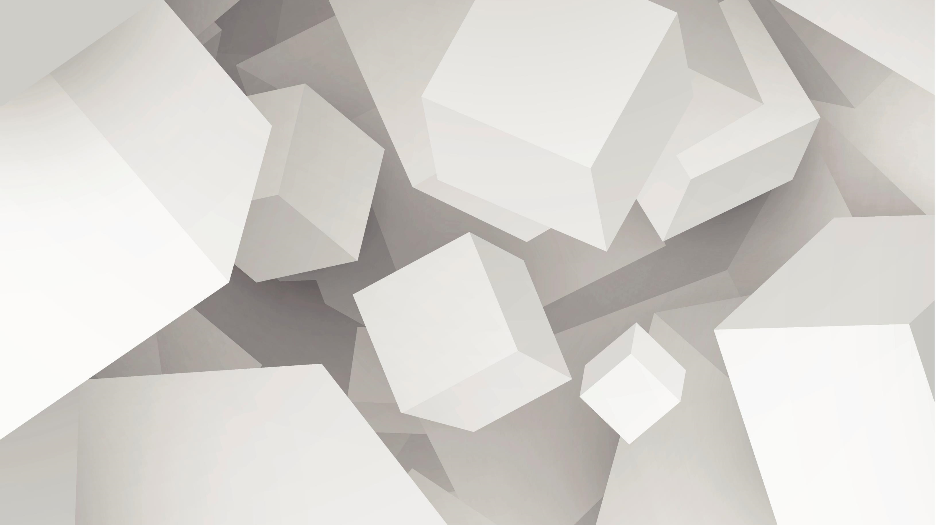
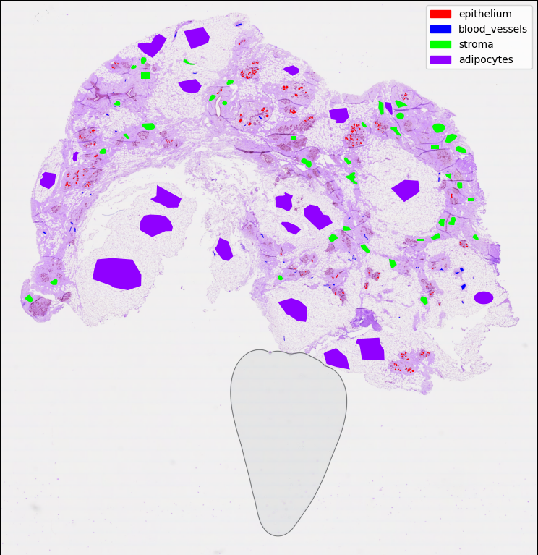
3D Breast Tissue Reconstruction with Deep Learning
Final Presentation

Slide 2
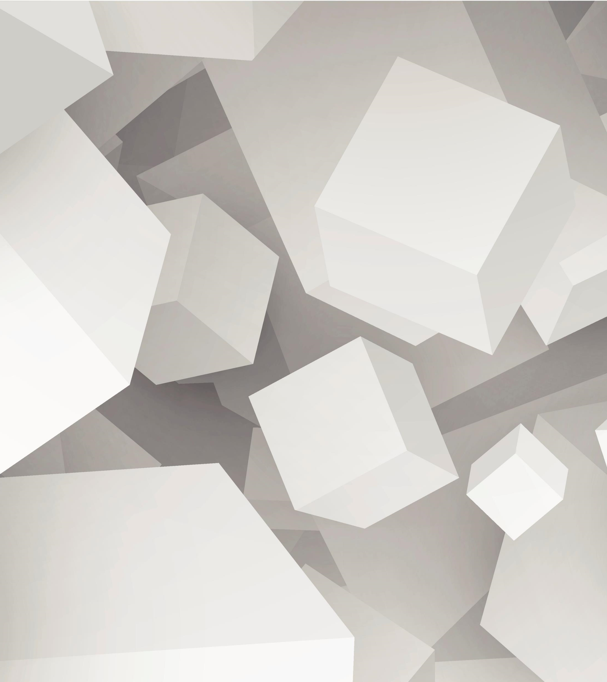

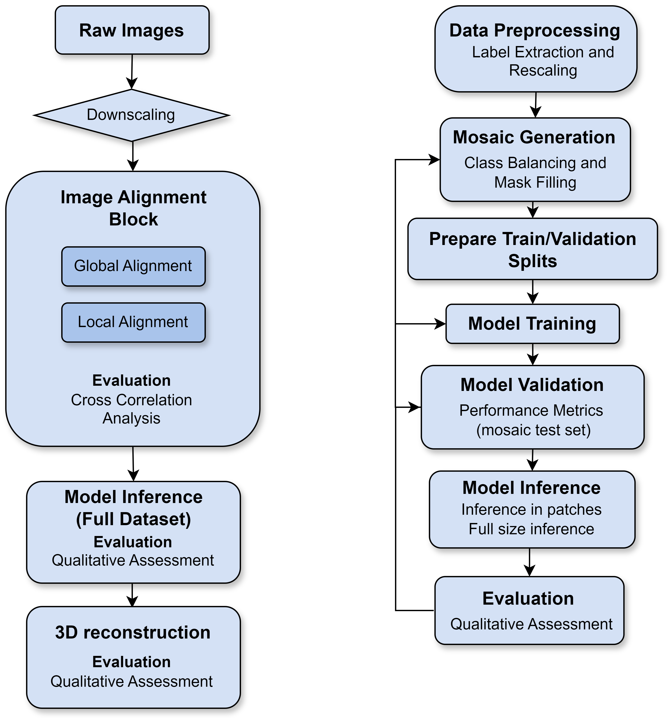
Project Goals
Automate downscaling
Image Alignment
Prepare the data and labels
Train Deep Learning model to classify breast tissue
Build the 3D based on predictions
Implement multiplex image registration
Multiplex 3D visualization
Multiplex/H&E integration

Slide 3
Automatic Downscaling
Converts files from .qptiff to .tif format
Works with both multiplex and H&E images
Down-sampled resolutions available: x1, x2, x4, …, x32
Before: Manually with Qupath can take hours.
Now: it takes minutes or a bit more depending on the resolution chosen. (this was tested on 100 H&E images)

Slide 4
Background Noise Removal
Air bubbles and dust harm the image registration, the Image Segmentation model and the 3D reconstruction:
Black holes has always a black color, we can use a HUE filter to detect it and remove it.
For the air bubbles edge detection algorithms work very well.
Varying size and number of these particles
Multiplex images also have some of this artifacts
Removing them can improve the alignment and 3D visualization

Slide 5
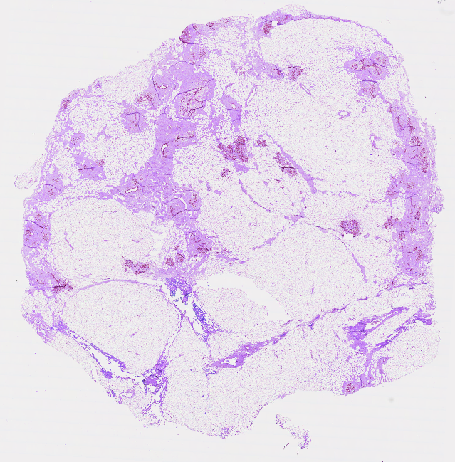
H&E Pipeline
Results

Slide 6
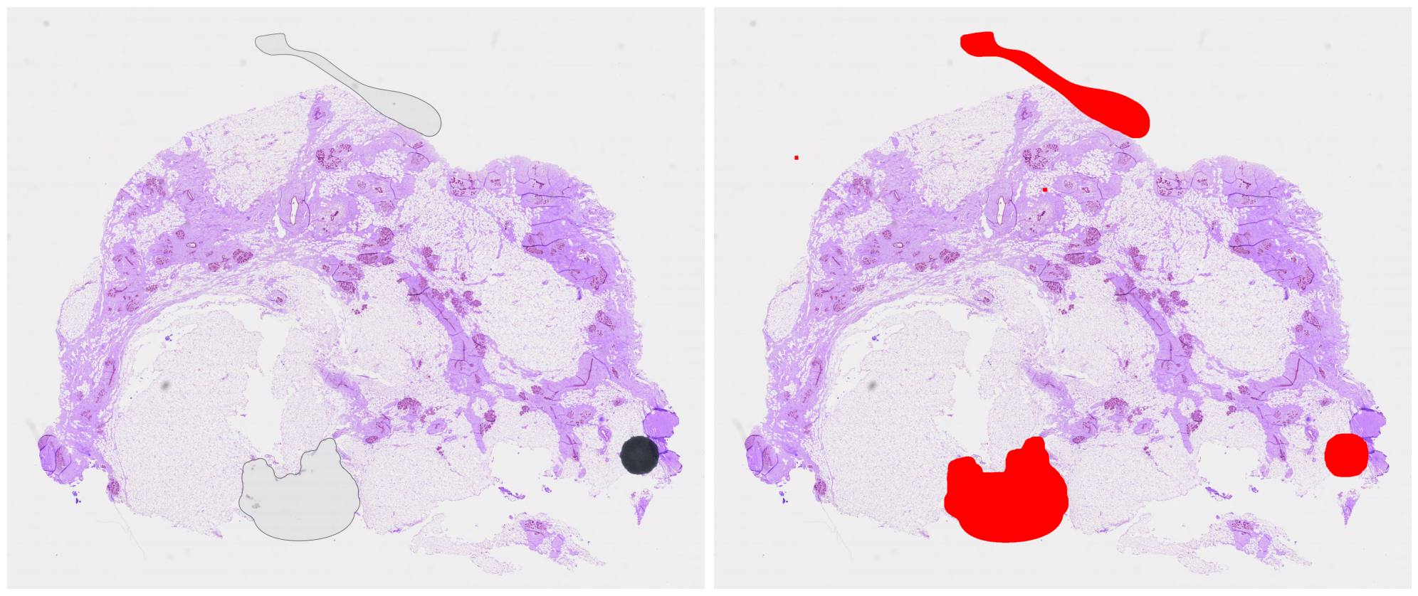
Background Noise Removal

Slide 7
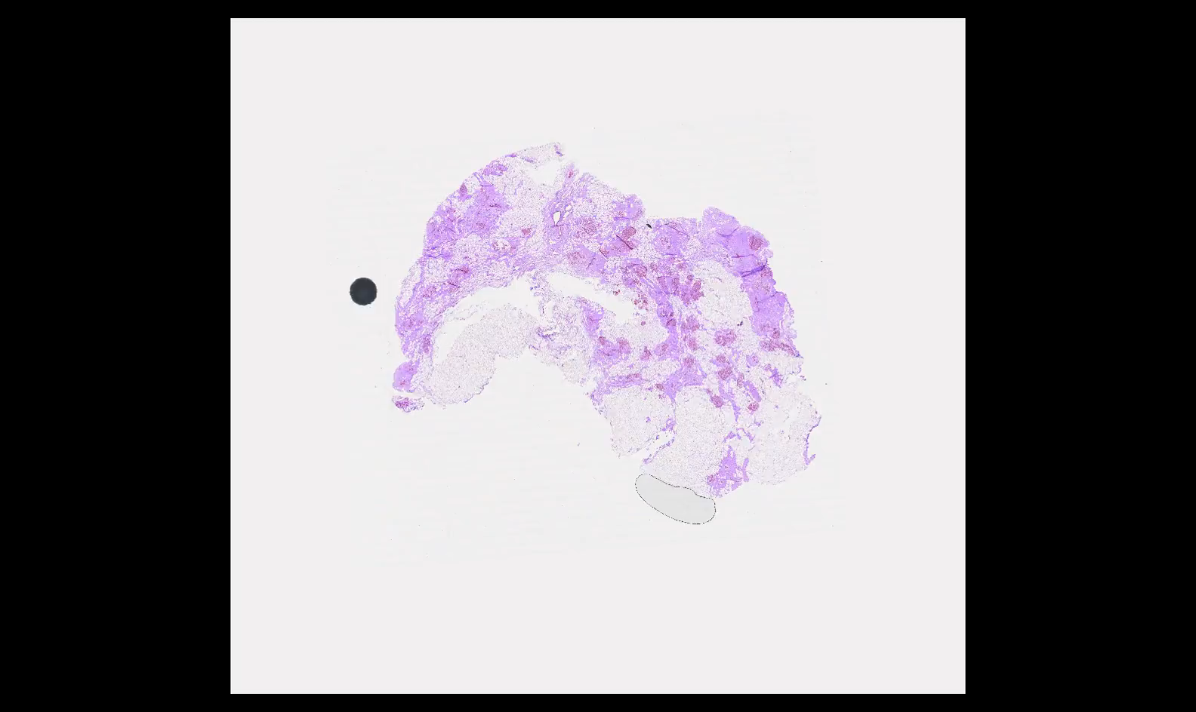
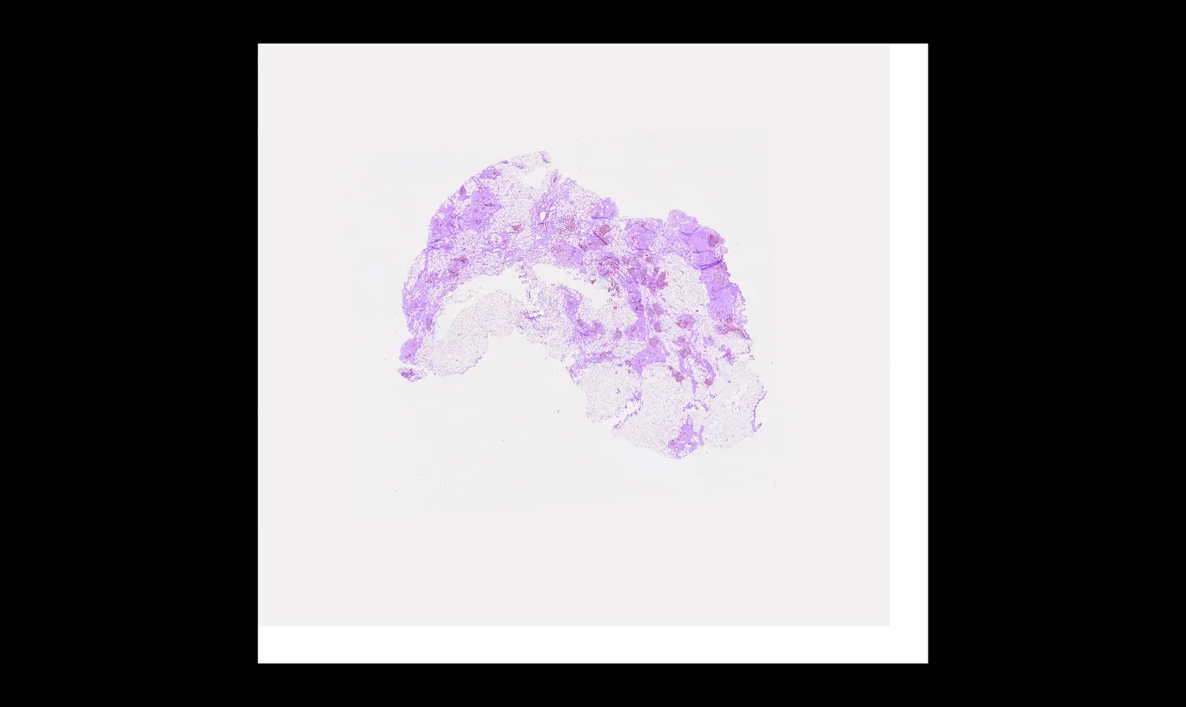
Image Alignment
Using CODAs code-base we can get the registered images aligned

Slide 8
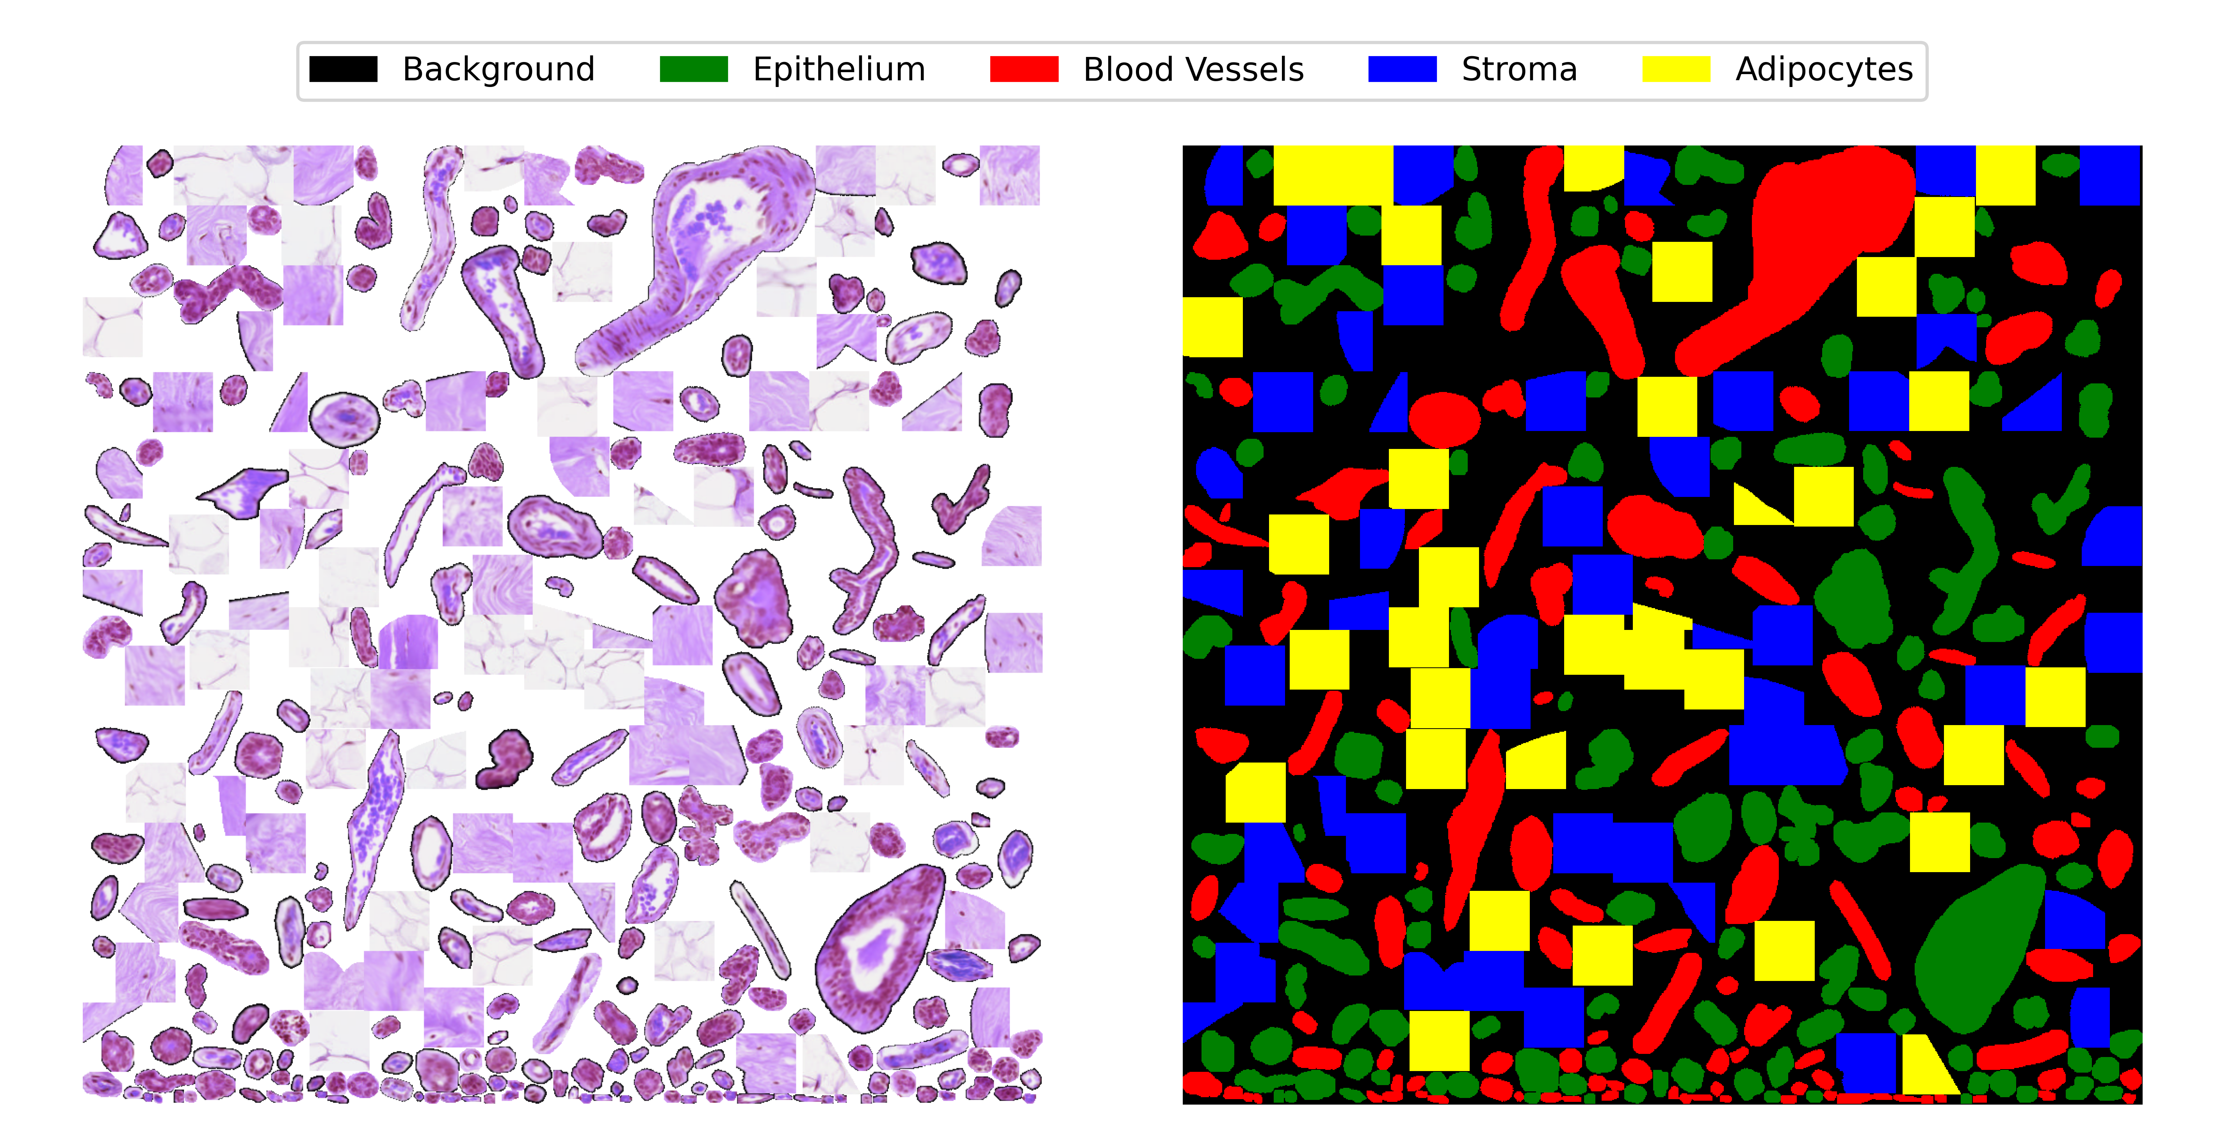
Data Preparation
Automated pipeline to extract and transform the labels from their corresponding images.
Build a mosaic of known areas of the image to train the Neural Network.
Keep percentage filled >65%
Keep number of pixels per label balanced

Slide 9
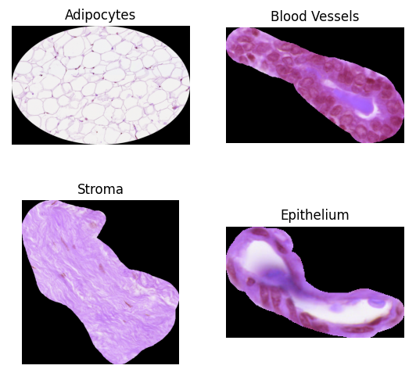
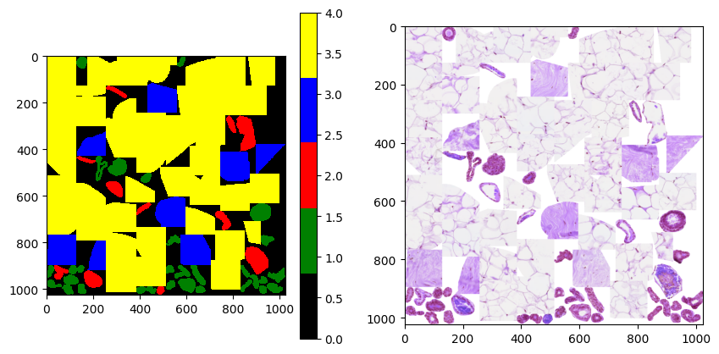
Data Preparation Intuition
Class Labels
{'epithelium':1, 'blood_vessels':2, 'stroma':3,
'adipocytes':4}
Image Mask (Labels)
Training Sample (76% full)

Slide 10
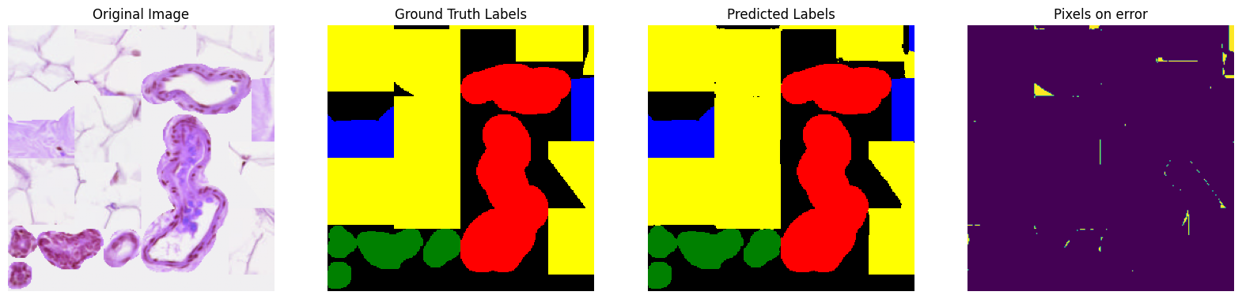
Predictions on mosaic
Best Model: traditional U-Net
Jaccard 97.59%

Slide 11
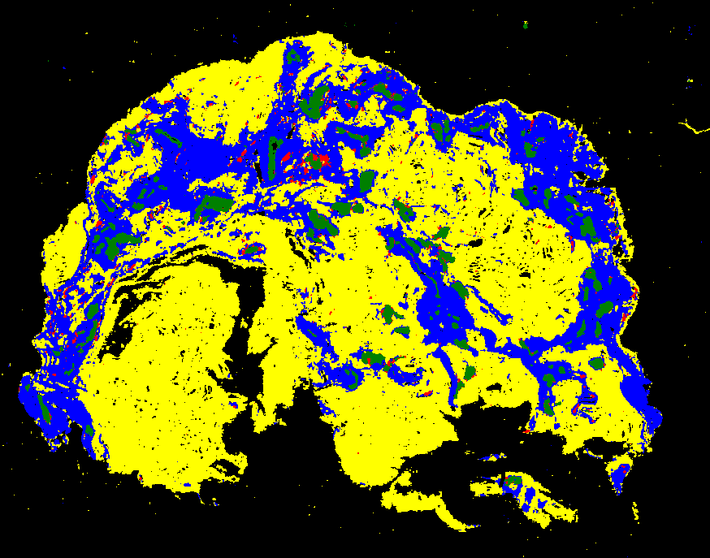
Predictions on Real Images

Slide 12
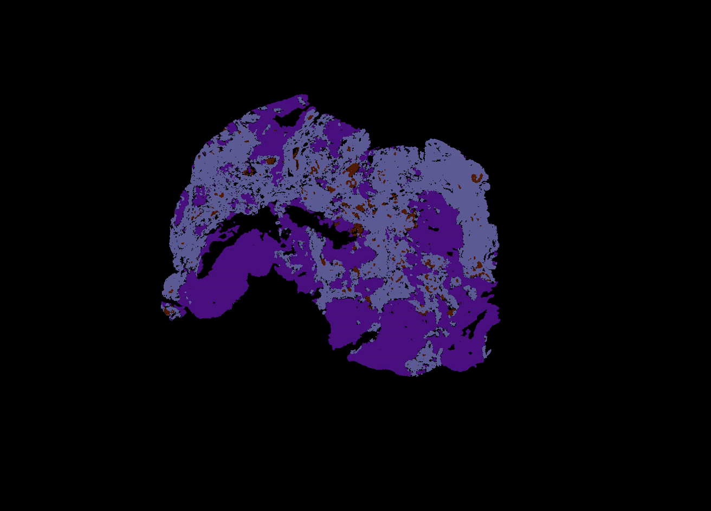
Demo video

Slide 13
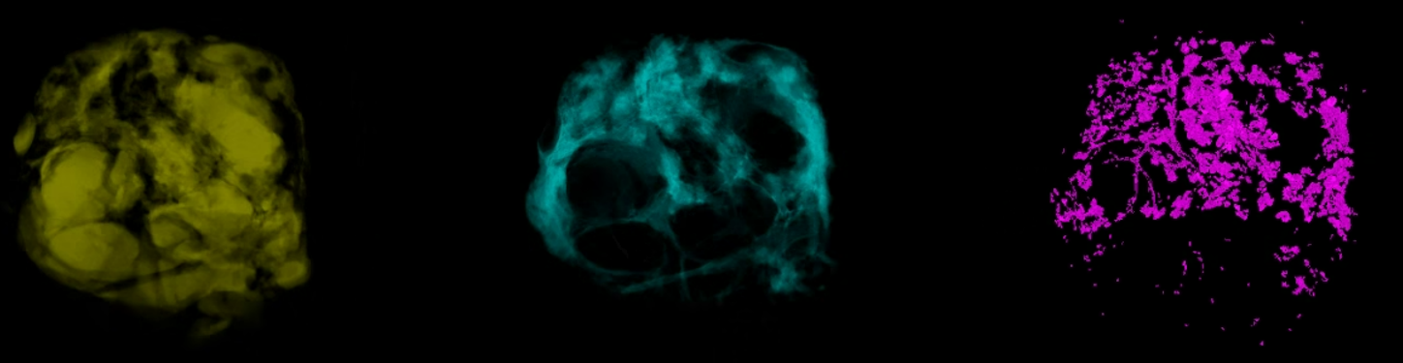
H&E – 3D reconstruction

Slide 14
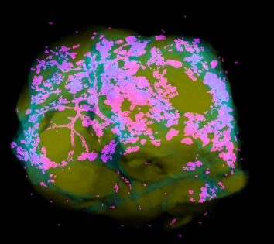
3D Samples

Slide 15
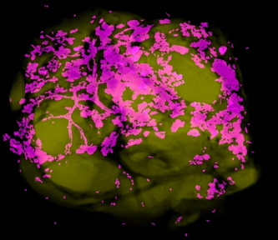
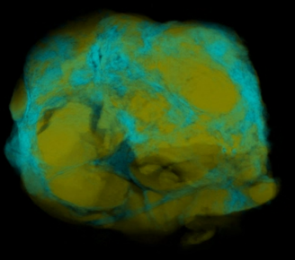
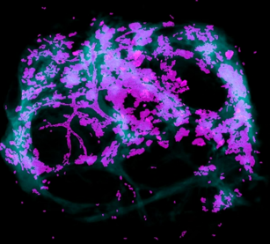
3D Samples

Slide 16
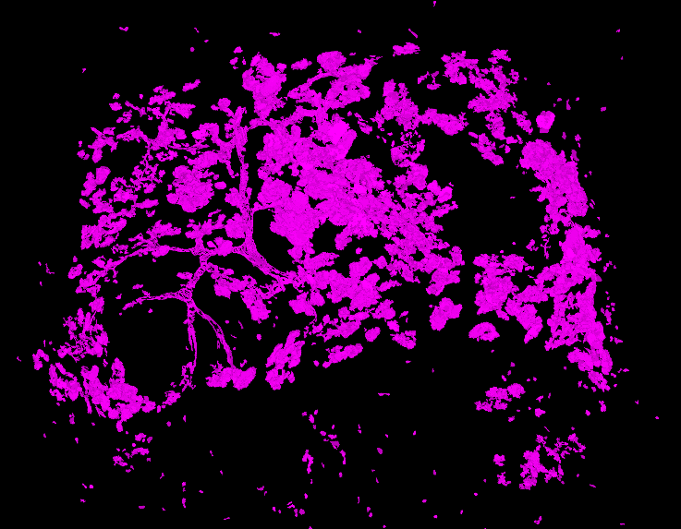
H&E – 3D reconstruction

Slide 17
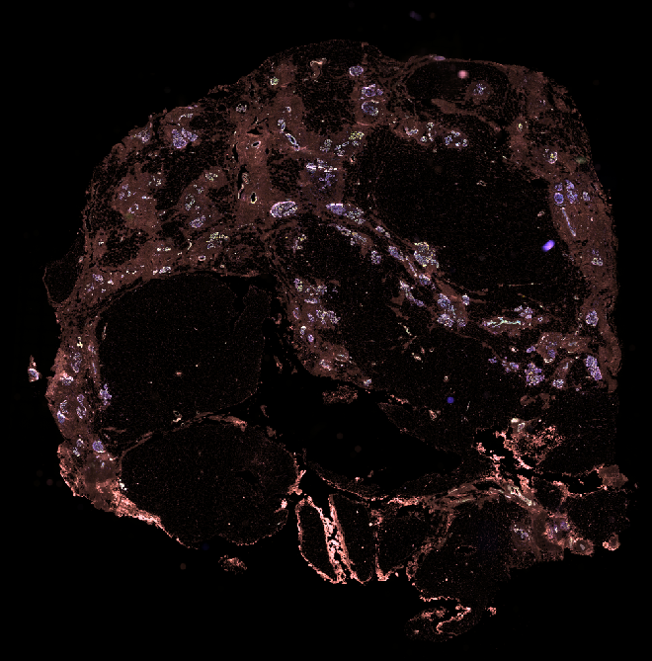
Multiplex
Results

Slide 18
Multiplex - Alignment
Approach 1: Using Stardist and Elastix to register
Multiplex - Multiplex based on DAPI channel
Multiplex - HE based on cell detection algorithms
Approach 2: Try use CODA to align the multiplex images
Get a single RGB image to align from each multiplexed channel via additive blending.
Align with multiplex and H&E combined
Align with multiplex only
Align creating multiplex subgroups

Slide 19
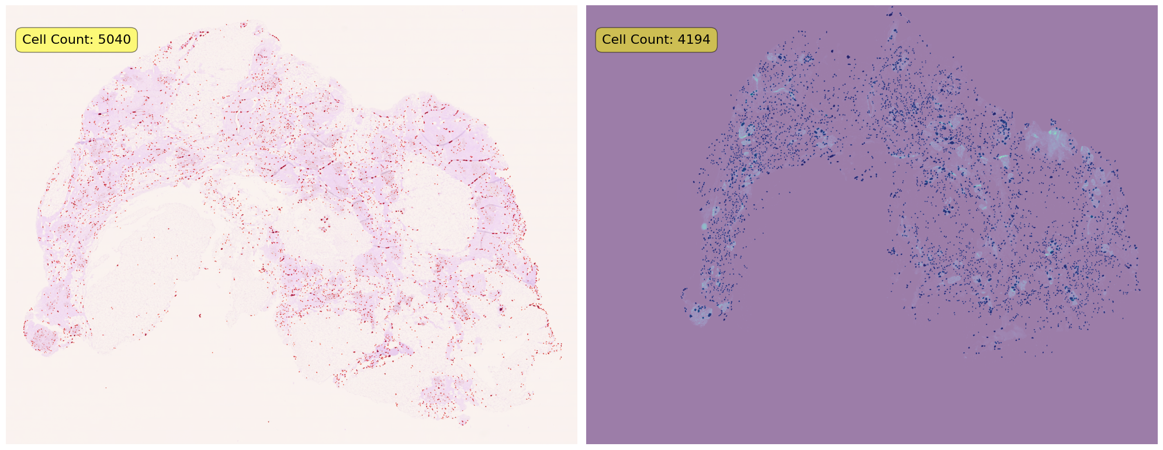
Multiplex - Alignment
Approach 1: Using Stardist and Elastix to align:

Slide 20
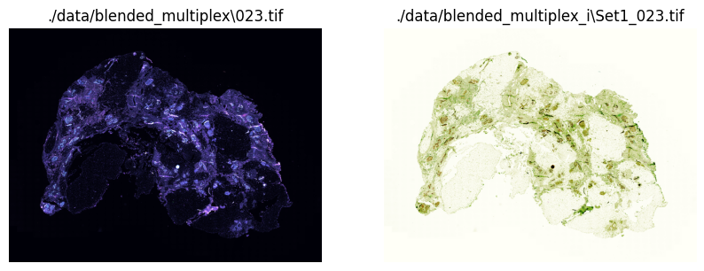
Multiplex - Alignment
Get a single RGB image to align from each multiplexed channel.
Test algorithms to measure alignment between multiplex consecutive slides.
Test algorithms to align the multiplexed image with the H&E ones.
See how to plot it in 3D.

Slide 21
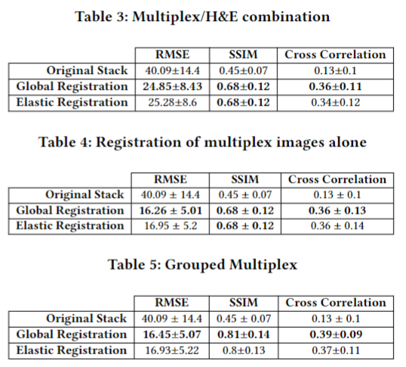
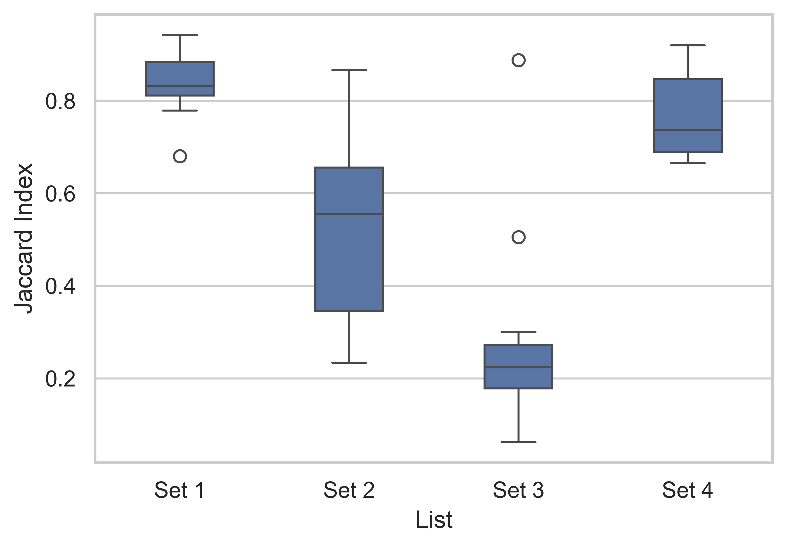
Multiplex - Alignment
Average 60% IoU
(these results are a bit biased due to thresholding innacuracies)
Grouped Multiplex with a global registration

Slide 22
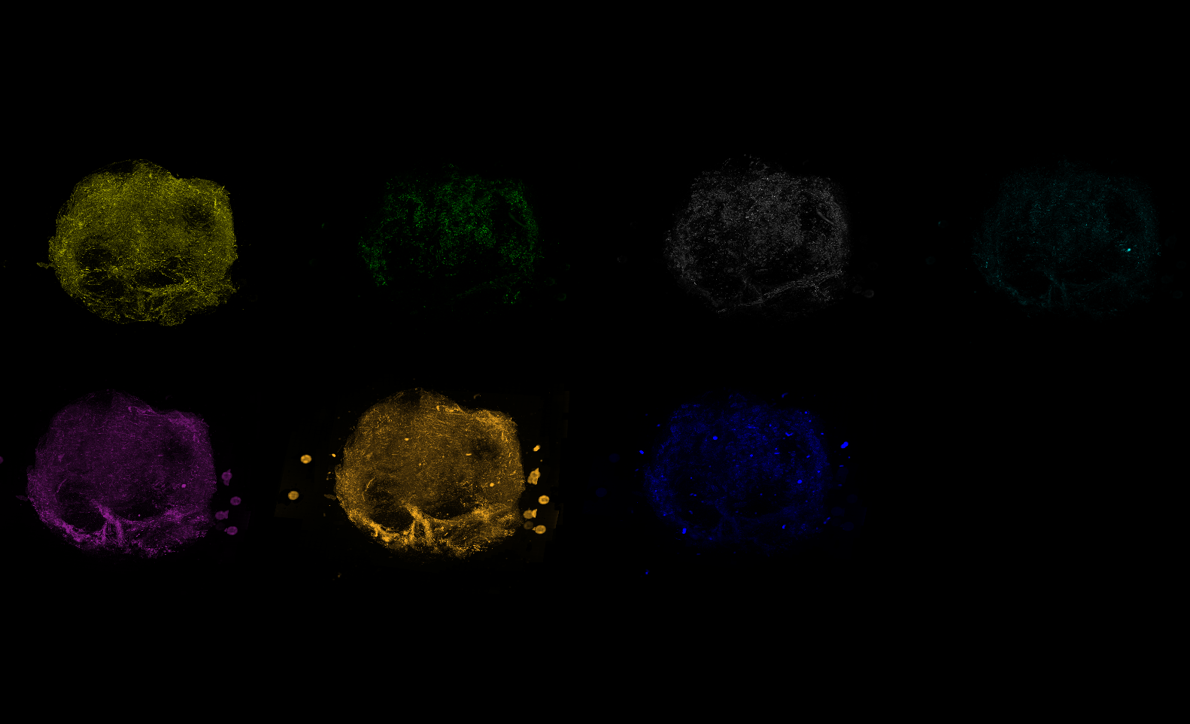
Multiplex – 3D reconstruction

Slide 23
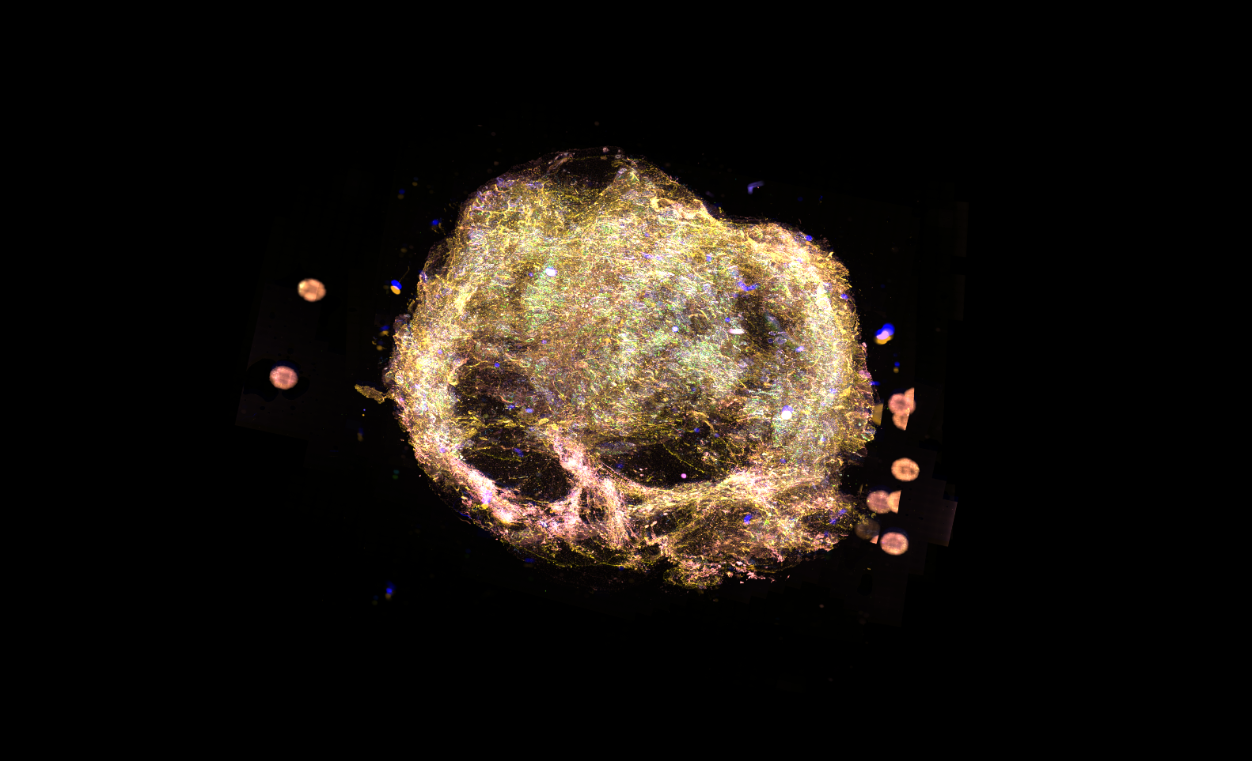
Multiplex – 3D reconstruction

Slide 24
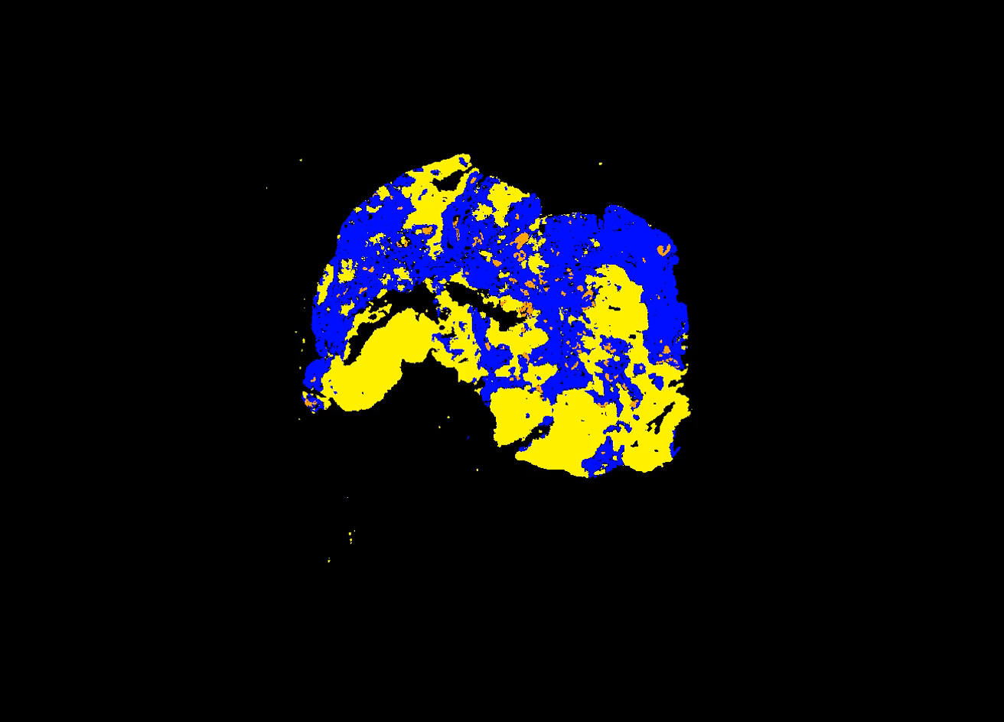
H&E /Multiplex – 3D reconstruction

Slide 25


Project Goals
Automate downscaling
Image Alignment
Prepare the data and labels
Train Deep Learning model to classify breast tissue
Build the 3D based on predictions
Implement multiplex image registration
Multiplex 3D visualization
Multiplex/H&E integration

Slide 26
Thank you!

